Slide 1
Module 41: Invoking Workflow Processes
Siebel Core Developer and Technology School
Notes:
Time: Lecture: 45 minutes; labs: 35 – 40 minutes
Intent: To explain three methods for invoking workflow processes: workflow policies, runtime events, and custom controls.
Flow: The module first introduces the three different methods for invoking workflow policies at high level. The slides then describe the steps for using workflow policies and how to create each of the pieces used in workflow policies. The properties that need to be defined for creating a runtime events are also explained in detail, as are the steps for invoking through a custom control. The module concludes with a slide comparing each of the three methods to help students understand when to use which type of method for their implementations.
Key Terms:
Workflow policy
Workflow group
Workflow policy action
Generate Triggers
Workflow monitor agent
Runtime events
Control user properties
Monitoring and diagnostics
Please note: Faculty-specific notes are italicized.

Slide 2

Module Objectives
After completing this module you will be able to:
  Describe the relationships between Workflow policies, Workflow groups, and Workflow policy actions
  Invoke Workflow processes using Workflow policy actions and runtime events
Why you need to know:
  There are different ways to invoke workflow, so you need to understand the available mechanisms in order to fully optimize application features

Slide 3
Invoking Workflow
A workflow process can be invoked by:
  Workflow policies
  Run-time events
  Custom UI elements
Workflow
Policies
Runtime
Events
Custom Control
Notes:
This is a structuring slide that explains the three major topics that will be covered in this module.
Note: Scripting is still a valid method for invoking workflows, but has been removed as a topic since we continually tell students to use scripting as a last resort.

Slide 4
Invoking via Workflow Policies
A workflow policy is a defined set of conditions and actions
  Actions are executed when conditions are met
Example: When a service request priority = Critical:
  Send urgent message to service request owner
  Update service request priority to Very High
Workflow
Policies
Runtime
Events
Custom Control
Conditions
Actions
IF <all conditions> = True
THEN <execute these actions>
Notes:
Policies are like the IF of an IF…THEN statement. If the conditions are met, then an action is executed. Policies determine the conditions to be met. Although this module completes with a comparison of each method, you may want to emphasize here that workflow policies are typically used to monitor conditions over time. The examples presented are this slide are accurate, however, they could also be address with a runtime event. A workflow policy would be used if service request priority = critical for a period of time, e.g., three hours. If the SR priority = Critical for three hours, then send an urgent message to the SR owner, or update the SR priority to Very High.

Slide 5
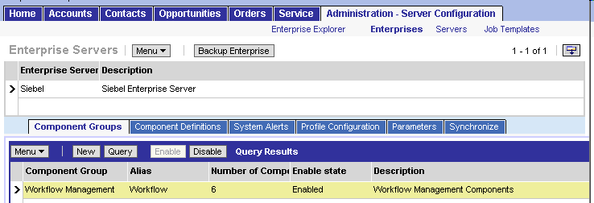

Requirements for Workflow Policies
Enable the Workflow Management component group
  Select Administration > Server Configuration > Enterprises > Component Groups
Workflow Component Definitions
Notes:
Before users can run a workflow process using Workflow Policies, the server components for workflow must be enabled. Users must check to see if the Workflow component group is enabled, and that each workflow server component is online. Workflows that are invoked using runtime events do not require the server component since they are invoked on the object manager.
There is a reminder in the student notes that if they enable a component group via the UI, they will need to stop and start the Siebel Server and Gateway Server services.

Slide 6
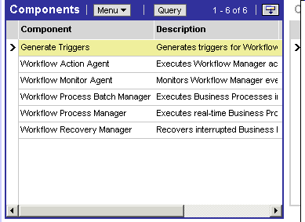
Workflow Component Definitions
Workflow Component Group consists of six server component definitions
Notes:
Each server component is explained in the student note, although this module covers only Generate Triggers and Workflow Monitor Agent.
Workflow Action Agent runs within Workflow Monitor Agent. There is no need to start Workflow Action Agent as a separate component on the server.
Refer to the Siebel Business Process Designer Administration Guide for more information on the Workflow Action Agent, Process Batch Manager, Workflow Process Manager, and Workflow Recovery Manager.

Slide 7
Steps for Defining a Workflow Policy
0/5
Create a Workflow Group
Create a Workflow Policy Action
Create a Workflow Policy
Generate Database Triggers
Start Workflow Monitor Agent
Notes:
This is a positioning slide; details are presented in the following slides.
The order of the steps is important. You might think that you would actually create the policy before the action. However, the action is created first, then the policy. Why? Because workflow actions can be used by multiple workflow policies.
Product Marketing recommends that customers use fewer workflow policies. Policies should be used primarily to invoke a workflow process. The workflow process should contain all of the complex logic. This means the Workflow Monitor Agent must still be started.
It is important to remember that you need to start the Workflow Monitor Agent. Because the Workflow Monitor Agent monitors groups and not policies, the policy must be part of a workflow group.

Slide 8
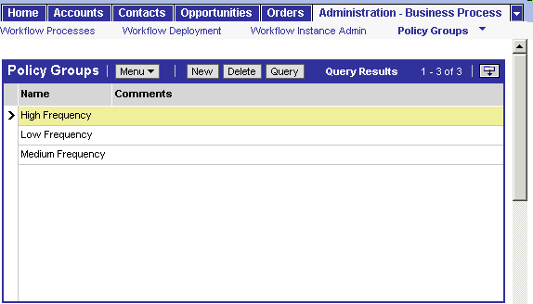
1. Create a Workflow Group
1/5
A workflow group is a collection of workflow policies that are monitored concurrently
To create a workflow group, select Administration - Business Process > Policy Groups
Monitor high frequency policies
Notes:
A workflow group can be made up of similar policies. As the slide suggests, this could mean all policies with a high frequency, or all policies dealing with integration, and so forth. Alternatively, all policies could be bundled together. All the policies in a group are monitored concurrently.
Each Workflow Monitor Agent is assigned one workflow policy group. The reasons to use multiple Workflow Policy Agents are:
To shorten the time between when the policy event is triggered and when Workflow Monitor Agent notices the event
To spread the workload across multiple application servers
To adjust the polling interval so that polling for non-critical policies does not prevent efficient processing of critical policies
Policies with similar time intervals are generally grouped together. By creating groups of policies with similar time intervals, you can assign the workflow policy group a Workflow Monitor Agent with a polling rate that matches the needs of the workflow policies. This results in a more efficient use of resources.

Slide 9
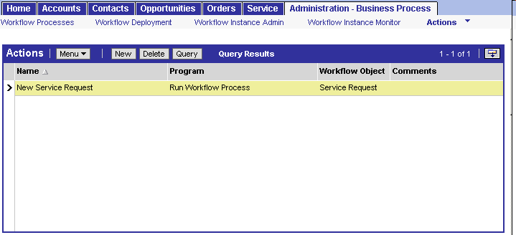
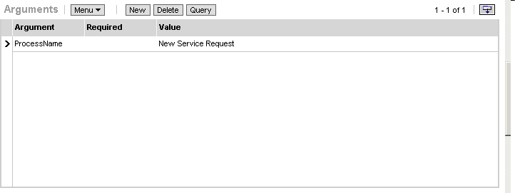
2. Create a Workflow Policy Action
2/5
Actions initiate a workflow process
  One policy can initiate several actions
  One action can be reused by several policies
To create an action, select Administration - Business Process > Actions
Specify Run Workflow Process program
Specify workflow process to invoke
Notes:
Workflow policy actions are events that users want to occur when the conditions of their workflow policy are met. They must create the necessary workflow policy actions before they create the policy that will use the action. If the action calls a process, the process must already be created in the application and have an Active status.
Demo: A demonstration suggestion is to go to some examples in the sample database and show the students an action. Be sure to go through the bullet points while looking at the demo. Note that actions are independent of policies. That is, they can be reused with other policies. For example, you may have an action that pages the Service Request Manager. Several different conditions could result in this action.

Slide 10

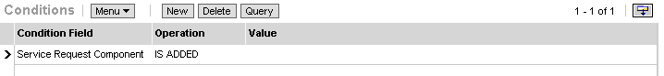
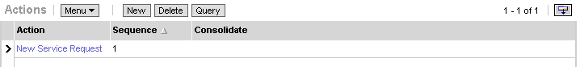
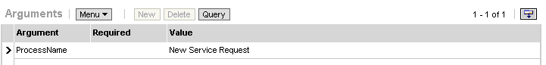
3. Create a Workflow Policy
3/5
To create a workflow policy, select Administration - Business Process > Policies
Create policy
Associate action to invoke workflow process
Workflow process to be invoked by policy
Notes:
For the policy, at least one condition must be defined, which causes an action to start a workflow process.
Summarize the pieces that make up a workflow policy.

Slide 11
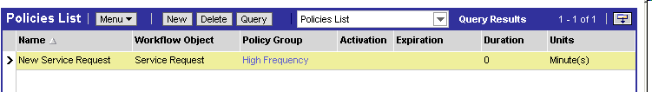
Triggering Policy Actions
All conditions must be met and the policy duration must be satisfied to trigger the workflow policy actions
Duration set to zero means policy is triggered as soon as the conditions are met
Notes:
In addition to conditions, duration is a factor for workflow policies. There must be a duration defined (even if it is zero) to fire triggers in the database. Once the policy conditions have been met, and the duration has been exceeded, then the action occurs.
As an example, consider a critical service request and a business rule by which a gold customer is to be contacted within 24 hours. For this example, the conditions to be met are 1) the service request is prioritized as critical, and 2) the customer is a gold customer. The duration in this example is 24 hours. After 24 hours have passed, the action calls a workflow process.

Slide 12
4. Generate Database Triggers
4/5
Workflow policies use database triggers to identify which records satisfy policy conditions
  A trigger is a process or a stored procedure attached to a table that fires when a specified data modification event occurs
When a trigger fires against a Policy Condition, a record is inserted in the Escalation Request Table (S_ESCL_REQ)
  S_ESCL_REQ contains all the rows in the database that could trigger a policy to take action
Generate Database
Triggers
Record is inserted, updated, or deleted
S_ESCL_REQ
Table updated
Notes:
Triggers monitor the database for records with conditions that match the policies.
The EXEC parameter must be set to TRUE for the Generate Triggers task, so that the Generate Triggers component automatically creates the SQL script and applies it to the server database. This will be practiced during the lab.

Slide 13
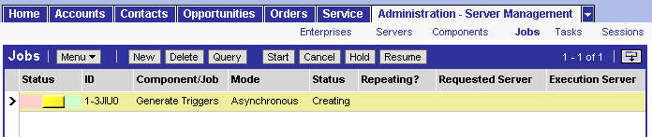
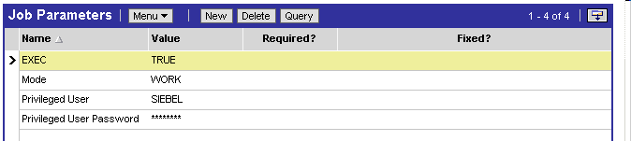
4. Generate Database Triggers Continued
4/5
To generate triggers, select Administration - Server Management > Jobs
Click Start to start Component Job
Create new Job and select Generate Triggers
Specify parameters
Notes:
This slide summarizes how to submit a Generate Database Triggers task. By default, the Generate Triggers component will generate triggers for both Assignment Manager and Workflow (Mode = ALL). If you set Mode = WORK then just workflow triggers are generated. Mode = ASSGN will generate triggers for Assignment Manager only.
The SQL file generated is called trigger.sql and is located in the Siebsrvr folder. When triggers find records that satisfy necessary conditions, they copy the records to the S_ESCL_REQ table.

Slide 14
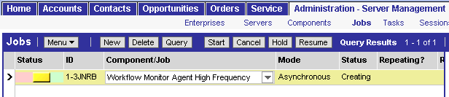
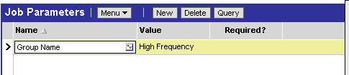
5. Start Workflow Monitor Agent
5/5
Monitors all policies within a single Workflow group
  Create a custom Workflow Monitor Agent component definition to specify a Workflow group
  Alternatively, start Workflow Monitor Agent using the Server Manager command-line interface
Select custom Workflow Monitor Agent component definition
Include parameter for the Group Name for this Workflow Monitor Agent
Notes:
In the previous version of this course, students used the command line interface to start the workflow monitor agent. Although this is still a valid technique, this module describes how to create a custom Workflow Monitor Agent component definition in the client application to start the Workflow Monitor Agent.
The lab provides detailed steps for copying an existing component definition to create a custom definition, then use this custom definition when the job is created.

Slide 15
Invoking via Runtime Events
A runtime event responds to an action or occurrence from a single user within a single user session
Workflow
Policies
Runtime
Events
Custom Control
Notes:
This slide introduces the runtime events topic; the following slides provide more detail.
A benefit of using run-time events is that it minimizes the need for custom scripting and workflow policy invocations. It provides for real-time monitoring of events and can be used to invoke and resume workflow processes.
Run-time events trigger workflow processes:
Based on personalization events
Specified when defining a workflow process
When a process with run-time events specified is activated, the run-time events also need to be reloaded. The preferred way to do this is to navigate to Runtime Event Administration, click the Menu button, and select Reload Personalization. This will load the run-time events in the current Object Manager session. For more information, refer to the Personalization Administration Guide.

Slide 16



Examples of Runtime Events
Event Object Type: Buscomp
Event: WriteRecord
Event Object: <Buscomp_Name>
Event Object Type: Buscomp
Event: CopyRecord
Event Object: <Buscomp_Name>
Event Object Type: Buscomp
Event: PreDeleteRecord
Event Object: <Buscomp_Name>
Notes:
Runtime events use a specific set of predefined methods. These methods are typically associated with a business component.
The first example on this slide shows how WriteRecord is invoked after a user has saved a record. Similarly, CopyRecord is invoked after a user has copied a record. Finally, PreDeleteRecord is invoked before a user deletes a record.
For a complete list of the available Business Component Methods, refer to the Siebel Object Interfaces Reference in Bookshelf.

Slide 17
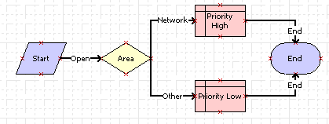
Using Runtime Events in Workflow
Example: This workflow process changes the SR priority to High when Area = Network
The process is invoked when a service request is created or updated and then saved
  The runtime event, WriteRecord, is specified on the branch following the Start step
Runtime event defined here
Notes:
Runtime events are defined on the branch following the Start step, so the process is invoked when the method specified in the runtime event occurs, such as when a service request is created (WriteRecord event).
The next slide shows the runtime event definition details for the Start step.

Slide 18
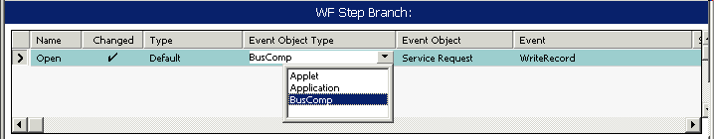
Using Run-Time Events in Workflow Continued
Specify the triggering event in the detail applet for the workflow step branch following the Start step
Business Component Events are most common for invoking Workflow processes
  Example: Specify an action that occurs to a field in the BC which will invoke the process
Select type of event
Specify BusComp to monitor for the event
Specify event to monitor
Notes:
Continuing the example from the previous slide, the run-time event is WriteRecord. The event object type is Business Component.
FAQ: Assume we reference a WriteRecord event for BusComp in a workflow process. What is the mechanism by which Siebel knows to access that specific Workflow Process when a user has added a record for that business component? What happens if two Workflow Processes make use of the same event/Buscomp combination?
Answer: When you reference an event from within a workflow process, Siebel automatically creates a Runtime Event record to trigger the workflow. If you navigate to Administration - Runtime Events > Events via the Site Map, you will see that a new Event has been created with a Sequence of -1 and an Action Set of "Workflow_<Workflow Process ID>". So now Siebel can use the same mechanism for triggering the Workflow as is used for any Runtime Event. The Sequence number of the Runtime Events determine the order in which they will be triggered if there are multiple Events for the same Object Type/Object Name/Event/Subevent combination. Any Event that Siebel automatically creates for a Workflow is given a Sequence number of -1.

Slide 19
Invoking Workflow Processes via Custom Control
Use Control User Properties to customize application behavior
  User clicks a button on an applet that launches a Workflow process
Workflow
Policies
Runtime
Events
Custom Control
Notes:
This slide introduces the custom control topic.

Slide 20
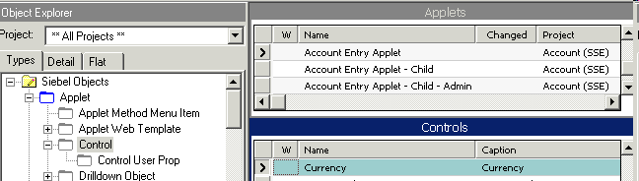
Example of Invoking from Custom Control
If Currency is USD, set price list to Americas Price List
  Specify Workflow process to invoke in the Control User Properties for the control
Notes:
Invoking a workflow process from a custom control is a less common method and is not explained in great detail in this module.
In this example, if the user selects USD in the currency control, a workflow is invoked to set the price list to Americas Price List.
To enable a control to invoke a workflow method, the developer has to create a series of user control properties and define the value for each based on the workflow process that will be invoked. As you can see from the screenshot in the instructor note below, the control user properties are not simple and intuitive.
For more information method, please see the PowerPoint presentation from Michael Bentley in InfoCenter:
InvokingWorkflowfromCustomUIelements1.ppt

Slide 21
Comparing Different Methods
Use different methods for different needs
Generate Triggers | Required | Not Required | Not Required
WF Monitor Agent | Required | Not Required | Not Required
Runtime Event | Not Used | Invokes process | Not Used
Synchronous | Asynchronous (runs in background) | Synchronous (runs in user session) | Synchronous (runs in user session)
Runs on Mobile Client | No (runs on Siebel Server) | Yes | Yes
Workflow
Policies
Runtime
Events
Custom Control
Notes:
The chart on this slide compares each of the methods discussed in this module to help students determine when to select which method.
The workflow policies are run in the background and require a Generate Triggers job along with a Workflow Monitor Agent. However, runtime events and processes invoked by a custom control occur during the user session. Workflow Policies also require the server component, whereas runtime events and custom control do not.

Slide 22
Workflow Scenarios
Which method is best for each scenario?
Send out a welcome letter each time a new account is created
Send out welcome letters at the end of the day to all new accounts that were created that day
Send an email alert to the manager when SR Status = Critical
Send an email alert to the manager when SR Status = Critical for more than 1 hour
Click Send Info (a new button) on the Account screen to send an account summary to the Team Lead
Workflow
Policies
Runtime
Events
Custom Control
Notes:
Use this slide to facilitate an interactive discussion with the students about when to use each type of method. Discuss these, then try to have the students come up with additional examples from their workplace.
In the first scenario, a Runtime Event is the right choice. However, compare this to the second scenario. Imagine a case where a new account is created, but two hours later, the customer changes his or her mind and decides to go with a different company. The account is deleted, but the welcome letter has already been sent. By using a Workflow Policy (as in the second scenario) you can ensure that the new account is valid at the end of the business day. Also consider sending out welcome letters weekly and how a Workflow Policy can be easily modified to change the interval.
In the third and fourth scenarios, compare an email alert that is sent out immediately when an SR Status goes Critical, vs. an email alert that goes out when SR Status = Critical for one hour. Using a Workflow Policy, you can set it up to wait for an hour to make sure an SR is really critical before it gets escalated to a manager.
The fifth scenario, as a new button, pretty obviously points to the Custom Control option. Compare this with runtime events. They are identical other than the configuration required to set up a custom control.

Slide 23
Administration, Monitoring, and Diagnostics
0/4
Detailed information allows better tracking and managing of workflow instances
Workflow Instance Deployment View
Policy and Frequency Analysis View
Workflow Instance Admin View
Workflow Instance Monitoring View
Notes:
This is a positioning slide; details are presented in the following slides.
In Workflow for Siebel 7.7, there are several new features that provide more information to enhance tracking and managing of Workflow processes. Specifically, there are three new views for administration, monitoring, and deployment. For instructor reference, in Siebel 7.0, the Workflow Process Log view was introduced to track and monitor progress of persistent flows. In Siebel 7.7, that view was broken up into these three new views. The main goal of this feature is to extend, add, and enhance the current implementation of workflow monitoring and error notification and to improve execution tracing for administrative and diagnostic capabilities.

Slide 24
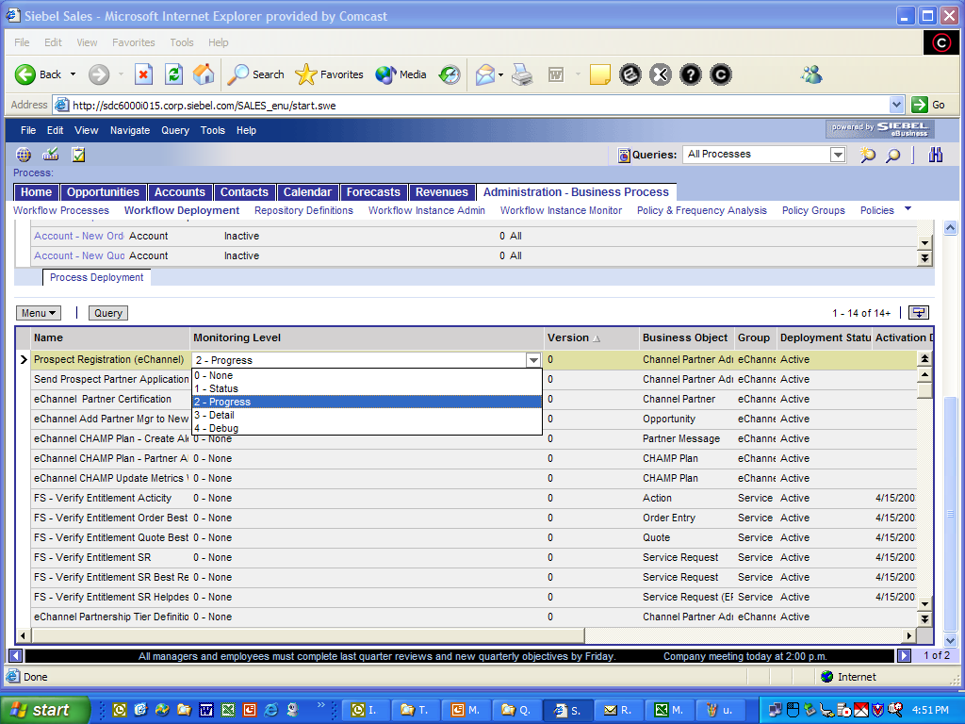
Workflow Instance Deployment View
1/4
Used to set Monitoring Level for Workflow processes
  Parameter changed at runtime—no need of server restart
Monitoring Level
Notes:
It is the Workflow administrator’s responsibility to set a monitoring level for Workflow processes. When the workflow instance is created, this monitoring level will be read from the workflow process definition and stay throughout the lifetime of the instance unless the instance was paused and was put to sleep. In that case, when an instance is resumed, the monitoring level is re-read from the definition.

Slide 25
Understanding Monitoring Level
1/4
Performance impact
  Monitoring level introduces performance overhead
  Recommended production setting is 1-Status
* In Debug mode, data is written to disk after every step
* In Detail, data is written at the end
Levels | Record Process Instance | Record Step Instance | Record Process Properties | Performance Impact
0-None | N | None | None | None
1-Status | Y | None | None | 5%
2-Progress | Y | All Steps | None | 25%
3-Detail* | Y | All Steps | All steps | 60%
4-Debug* | Y | All Steps | All Steps | 75%
Notes:
Here’s a graph that explains the performance impact of the various monitoring levels that the administrator may select.
During deployment, an administrator can select one of the following monitoring levels for a workflow process. In production you may only want to use level 3 or 4 for a short period of time in case you need to debug problems with the workflow process. It would not be advisable to use this setting as a default.
For example, a monitoring level set to 1 – Status decreases performance by about 5%. However, a monitoring level set to 4 – Debug can slow performance as much a 75%.

Slide 26
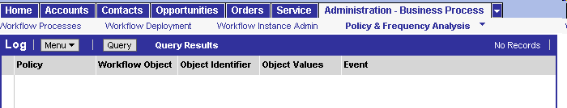
Policy and Frequency Analysis View
2/4
Used to display a log of all the policies executed in a single group monitored by Workflow Monitor Agent
Provides information about the number of times a Workflow policy executes and execution trends
  Log: Lists Workflow policies
  Chart: Displays execution frequency of a selected policy in chart form
Displays executed policies in top applet, frequency chart in bottom applet
Notes:
This view is used to monitor workflow policies from a single group. As these policies are executed, they are displayed in the top applet, and the bottom applet displays the frequency of each policy in the bottom applet. This is helpful information for understanding how many times policies are executed (how often conditions are met).

Slide 27
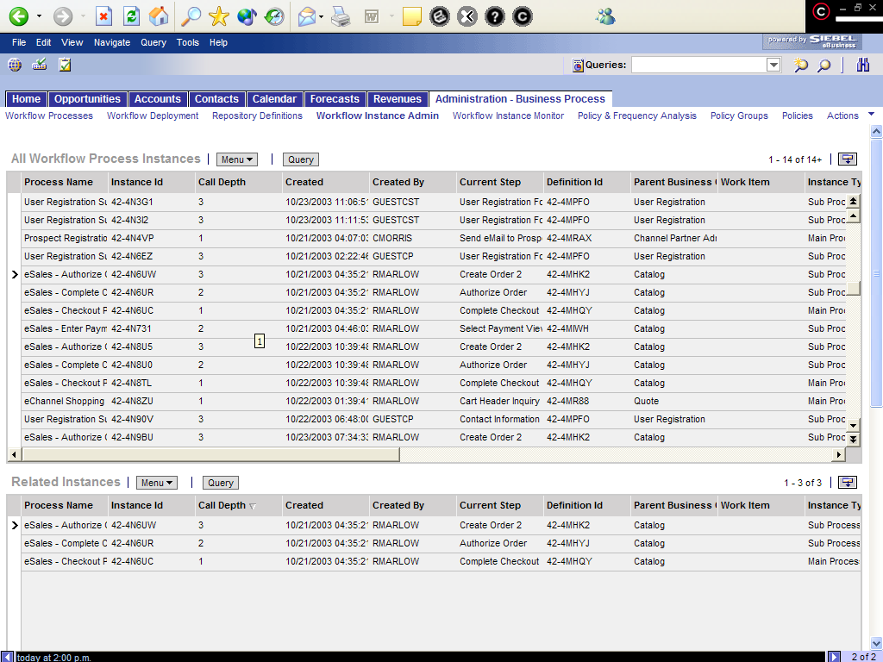
Workflow Instance Admin View
3/4
Lists all instances in Running, Waiting, or Error states
Allows manual recovery
Workflow Instance Admin View
Lists all persisted instances
Lists all related instances
Lists all process properties data
Notes:
The Workflow Instance Admin view provides a mechanism for tracing Workflow details and keeping track of Workflow states. This view includes all processes with a state of running, as well as processes that are waiting or in error. The second applet lists all associated processes for the parent process instance. There is also a third applet that shows all the process properties for the selected instance in the middle applet. A Workflow administrator can change the value of these process properties before resuming an instance in Wait state or In-error state.

Slide 28
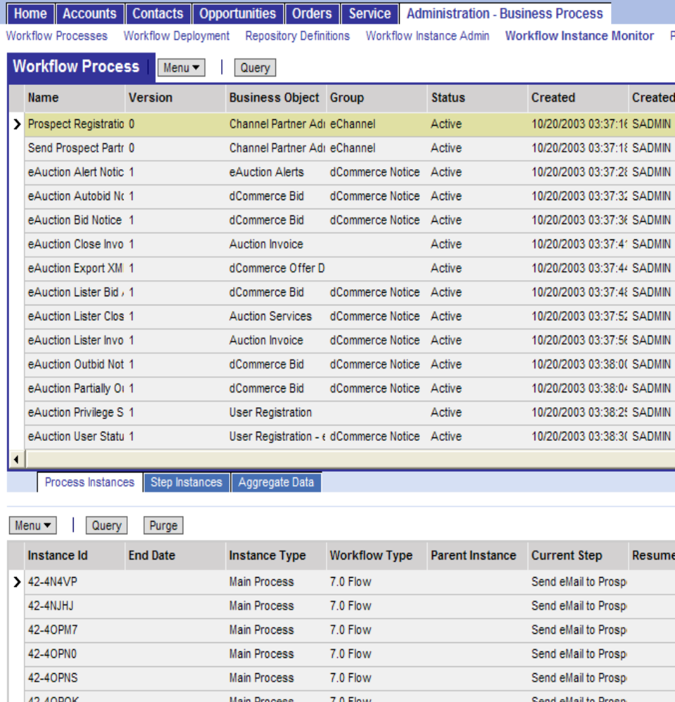
Workflow Instance Monitor View
4/4
Lists all instances whose monitoring levels are set
Integrated with chart server to display aggregate information
Workflow Instance Monitor view
Process Instances applet shows detail
Notes:
In the Workflow Instance Monitor view, the top applet shows all the Workflow definitions that have monitoring turned on, meaning that the monitoring level is not NONE. The bottom applet, Process Instances, shows the related log instances for the Workflow definition selected in the parent applet. Note that an administrator can purge log instances from bottom applet by clicking the purge button in the lower applet.
If you click and drill down on the second applet on Instance ID, you will be navigated to the Steps Instances view showing the steps and process properties for that particular instance. Similarly, if you highlight a record in the 2nd applet and then click on the Steps Instances View tab, you will also be navigated to the Steps Instances view.

Slide 29
Summary
This module showed you how to:
  Describe the relationships between Workflow policies, Workflow groups, and Workflow policy actions
  Invoke Workflow processes using Workflow policy actions and runtime events
Notes:
Review Question: Why should you create a workflow policy action before you create the workflow policy?
Answer: Workflow policy actions can be associated with multiple policies. When you create the policy, you can select with workflow policy actions will be executed by that policy.
Review Question: What is one example of a runtime event method explained in this module and when is that event used?
Answer: WriteRecord method is invoked after a user has saved a record. CopyRecord method is invoked after a user has copied a record. PreDeleteRecord method is invoked before a user deletes a record.
Review Question: In which view does the workflow administrator set the monitoring level?
Answer: Workflow Instance Deployment View
Review Question: When would you set the monitoring level to 4?
Answer: To record data after every step in the process is executed, set the monitoring level to 4. However, this monitoring level can also decrease performance as much as 75%.

Slide 30
Lab
In the lab you will:
  Create a workflow policy to invoke the ABC Insert SR Activity workflow process when correct conditions are met.
  Create triggers in the Siebel database to support workflow policies and start the Workflow Monitor Agent task.
  Invoke the workflow process via a workflow policy.
Notes:
See lab instructions for details.
In the first three labs for this module, students go through the steps to create a workflow policy group, a workflow policy, and a workflow action agent component definition. Please note that these labs differ from the Siebel Essentials 7.0/7.5 version of the course since students do NOT use the command prompt to start the workflow monitor agent. In the final lab, students will invoke a process using a runtime event. There are currently no troubleshooting tips for these labs.
Please note: There are not solution documents for labs 41-1 and 41-3.

